Slide 1

SQL - Joins

Slide 2
Contents
ERD - Brief Review
Why using JOIN?
JOIN Statement
INNER JOIN
LEFT JOIN
RIGHT JOIN
FULL OUTER JOIN

Slide 3
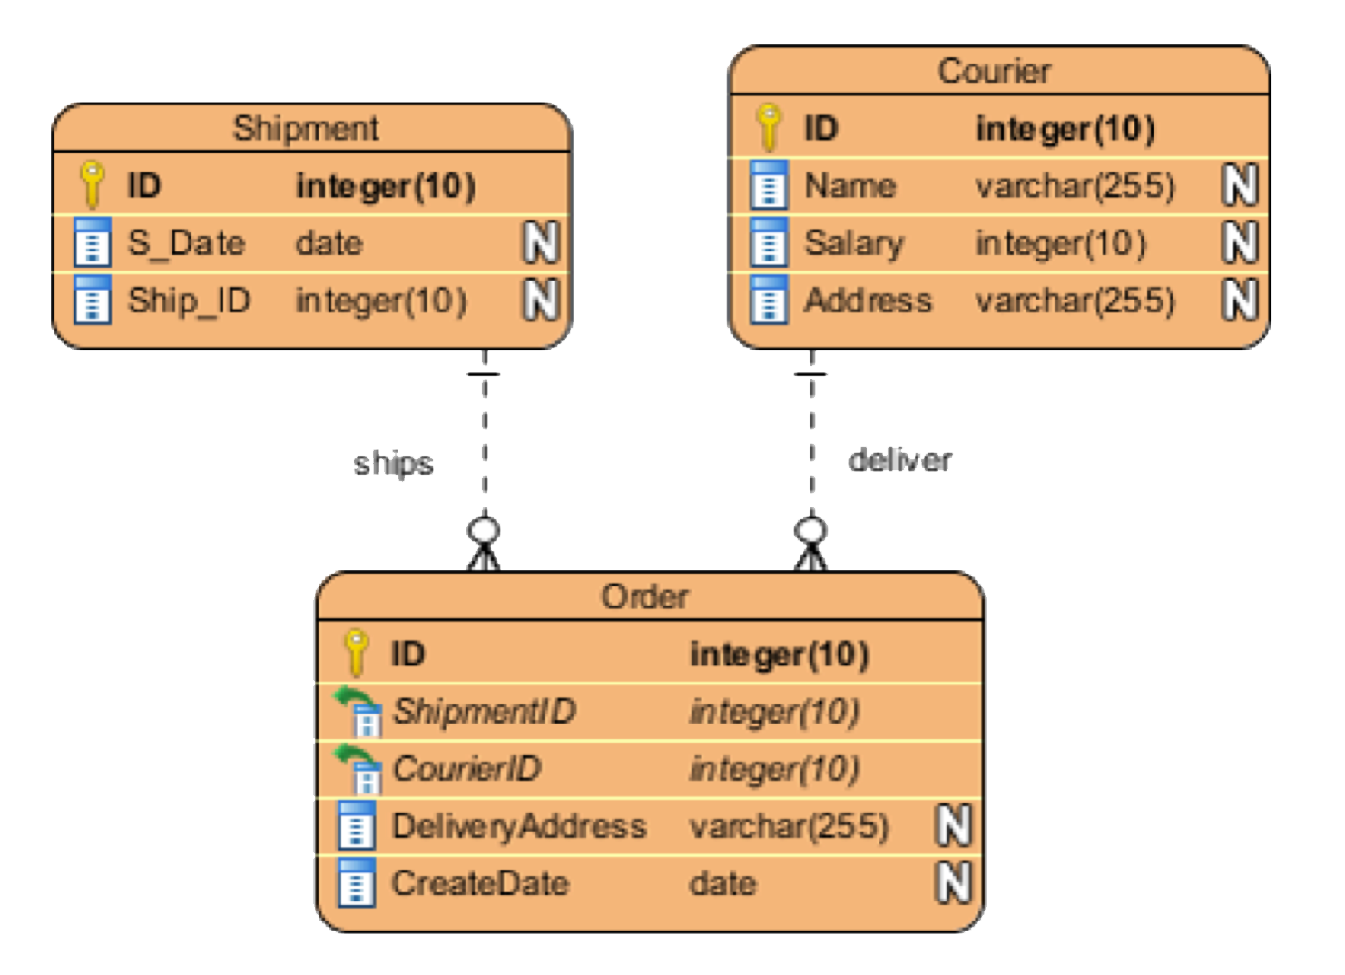
Using multiple tables
Take a look at our friend, the ERD:
So far, we just used one entity
Power of SQL comes from the fact we can run queries against multiple tables at once
JOINS are the statement we use to ‘connect’ the tables together
Joins work thanks to Normalization, a design technique that reduces data redundancy

Slide 4
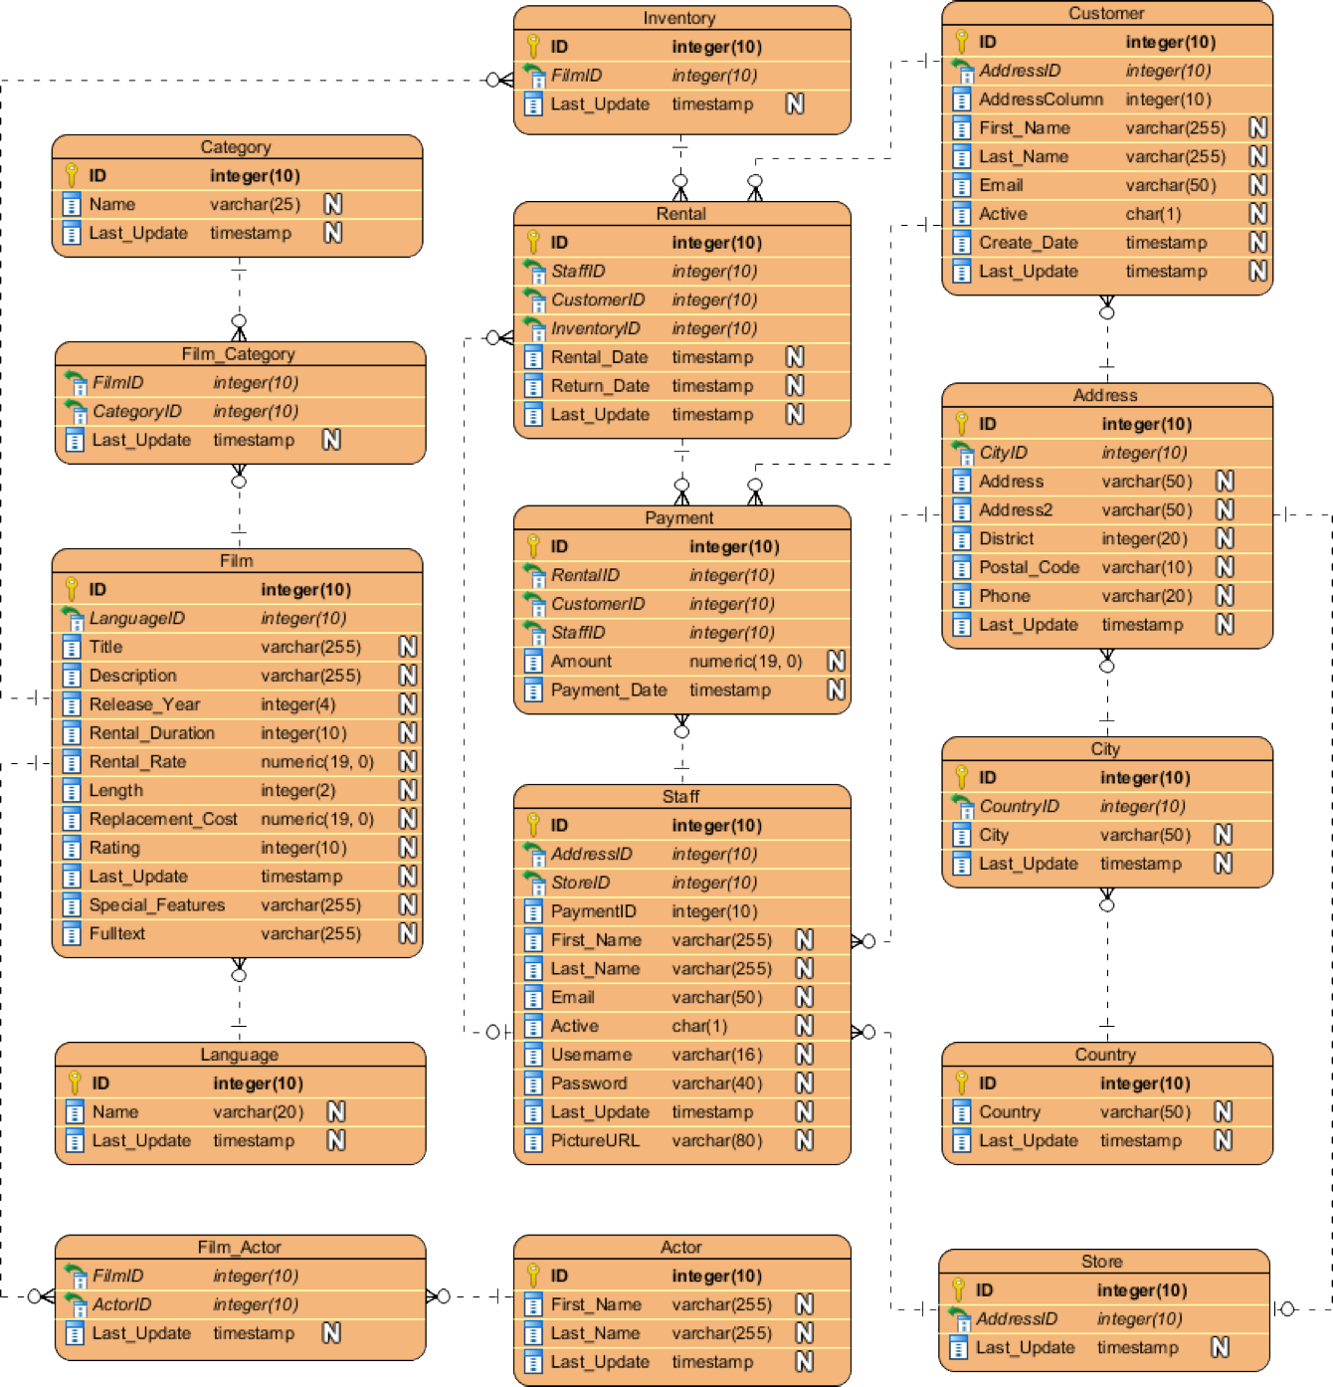
EDR Brief Review
Primary Key (PK): Unique identifiers
Foreign Key (FK):
Is a column in one table which is a PK
Crow’s foot:
Indicates many of the instances of a FK
Dash line:
indicates only one instance of PK will be present in this table

Slide 5
EDR Brief Review
One to Many relationships
Each Customer has a unique ID.
ID it is the PK of the customer table
Thus, we will find a single ID for each customer
This ID is also present in the Rental, Payment
In those tables, it is present as a FK
Thus, we might find the same Customer ID for many rental operations.

Slide 6
EDR Brief Review
Many-to-Many relationships
There are many categories
There are many films
One film can have many categories
One category can be related to many films
Since PKs have to be unique, many to many relationships have to resort to a intermediate step (Film Category)

Slide 7
EDR Brief Review
How can we leverage these relationships?
As many tables are connected, we can perform interesting analyses
We can see, for example, the stores in UK
Let’s see this without using JOIN first

Slide 8

Why using JOIN
First, let’s find the UK id
SELECT * FROM country
WHERE country = ‘United Kingdom’;
We can look cities whose country_id =102

Slide 9
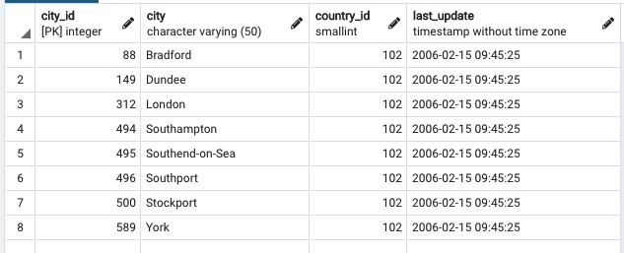
Why using JOIN
SELECT * FROM city
WHERE country_id = 102;

Slide 10
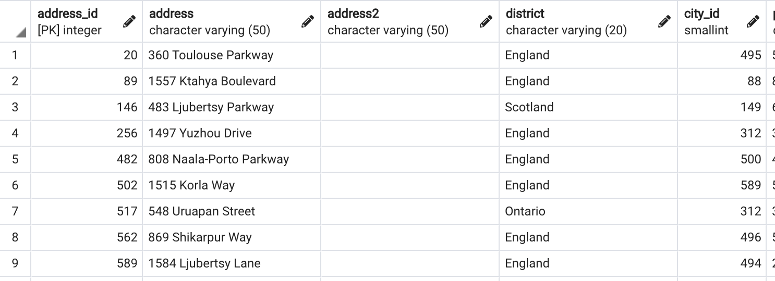
Why using JOIN
SELECT * FROM address
WHERE city_id IN (88, 149, 312, 494, 495, 496, 500, 589);

Slide 11
Why using JOIN
The process is tedious
We have to code the IDs manually
We can’t guarantee that we got all the IDs
JOIN makes this process simple
There are four type of JOIN

Slide 12
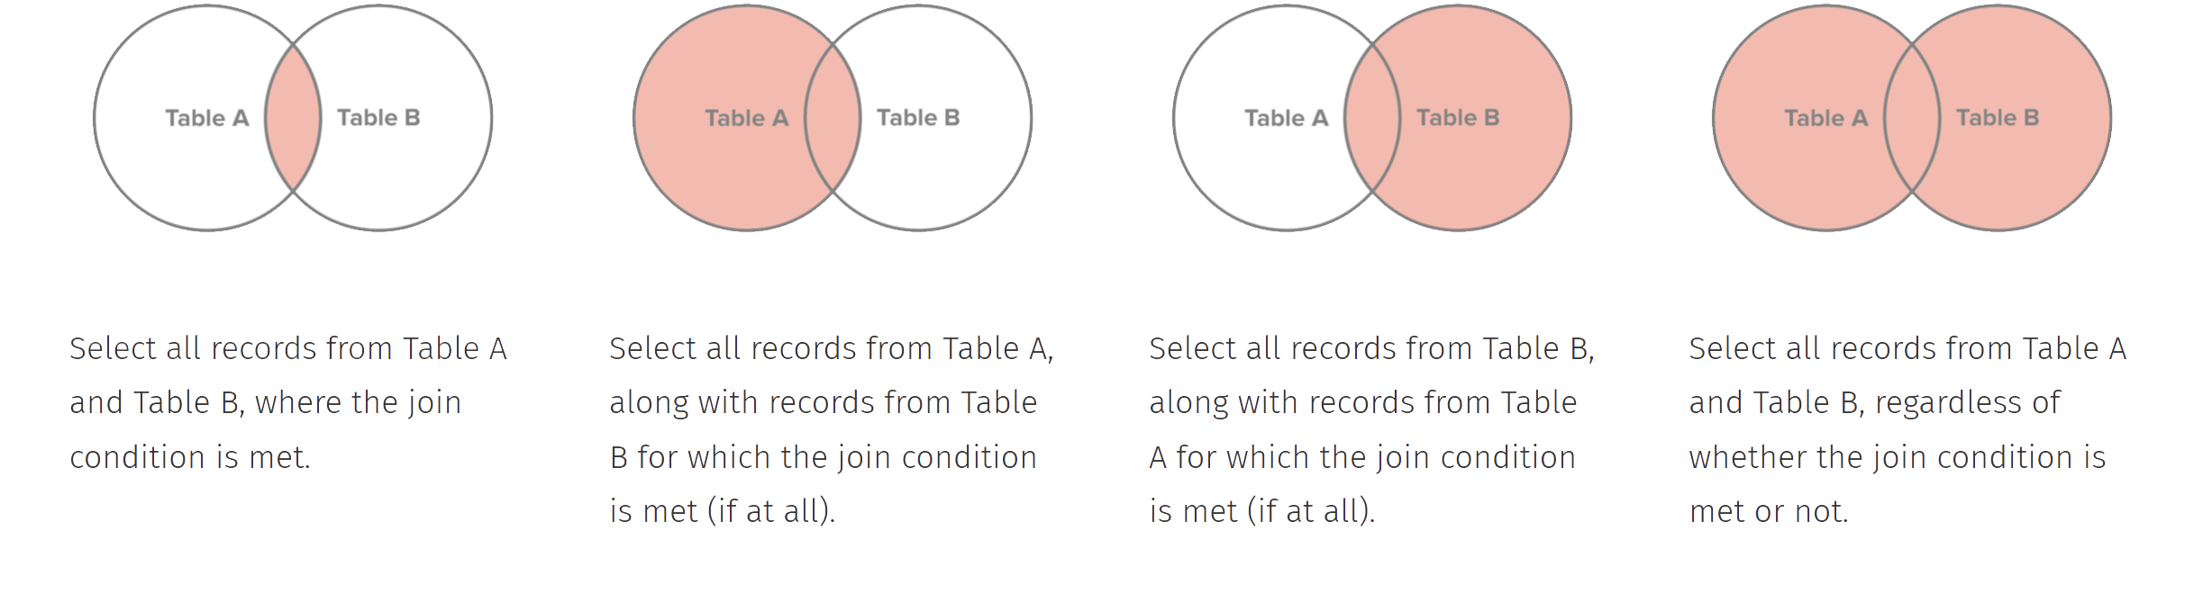
Why using JOIN
There are four type of JOIN:
INNER JOIN
LEFT JOIN
RIGHT JOIN
FULL OUTER JOIN

Slide 13
JOIN Statement - INNER
INNER JOIN: Connects rows based on a condition known as the join predicate. It has the same functionality as JOIN (pure syntactic sugar when you have different type of JOINs)
SELECT {columns} FROM {table_1} INNER JOIN {table_2}
ON {table_1}.{common_key_1} = {table_2}.{common_key_2}

Slide 14
JOIN Statement - INNER
SELECT *
FROM country
JOIN city
ON country.country_id = city.country_id
WHERE country = 'United Kingdom';

Slide 15
JOIN Statement - INNER
We can JOIN ON more than one table
SELECT *
FROM address
JOIN city
ON address.city_id = city.city_id
JOIN country
ON city.country_id = country.country_id
WHERE country = 'United Kingdom';

Slide 16
JOIN Statement - INNER
We might want to get only the columns that belong to a certain table
SELECT address.*
FROM address
JOIN city
ON address.city_id = city.city_id
JOIN country
ON city.country_id = country.country_id
WHERE country = 'United Kingdom';

Slide 17
Aliasing
Aliasing allows us to create temporary variables which we can reference in our query
Typically we alias our tables as just the first letter of the table name
We can actually omit the AS, but it’s in this example for clarity
SELECT address, city
FROM address AS ad
JOIN city AS ci
ON ad.city_id = ci.city_id
JOIN country AS co
ON ci.country_id = co.country_id
WHERE country = 'United Kingdom';

Slide 18
Practical - Part I
Go to the portal and complete the first practical in this lesson: “Using JOIN statements”

Slide 19
JOIN Statement - LEFT
There are four type of JOIN:
INNER JOIN
LEFT JOIN
RIGHT JOIN
FULL OUTER JOIN

Slide 20
JOIN Statement - LEFT
LEFT JOIN
The left table will have every row returned
Matches every row to the row in the right table (based on the ON condition)
If the ON condition is True, columns from both tables are combined
If the ON condition is False, a new row is still added but with a NULL value

Slide 21
JOIN Statement - LEFT
There might be some stores with no clients registered:
SELECT ad.address_id, cu.*
FROM address AS ad
LEFT JOIN customer AS cu
ON ad.address_id = cu.address_id
WHERE cu.customer_id IS NULL;

Slide 22
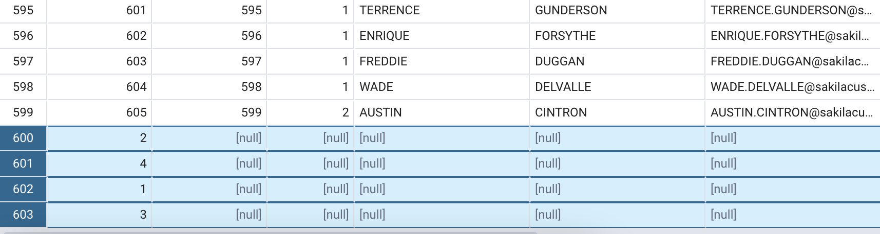
JOIN Statement - LEFT
There might be some stores with no clients registered:

Slide 23
JOIN Statement - RIGHT
There are four type of JOIN:
INNER JOIN
LEFT JOIN
RIGHT JOIN
FULL OUTER JOIN

Slide 24
JOIN Statement - RIGHT
RIGHT JOIN
Very similar to LEFT JOIN
The output is similar, but just switched positions
SELECT as.address_id, cu.*
FROM customer AS cu
RIGHT JOIN address AS ad
ON cu.address_id = ad.address_id;

Slide 25
JOIN Statement - FULL OUTER
There are four type of JOIN:
INNER JOIN
LEFT JOIN
RIGHT JOIN
FULL OUTER JOIN

Slide 26
JOIN Statement - FULL OUTER
FULL [OUTER] JOIN
Take all data from both tables, regardless of the matches.
Let’s see the example from the previous slides (The employees exercise)
SELECT *
FROM employee_details AS det
FULL OUTER JOIN employee_salary AS sal
ON det.employee_id = sal.employee_id;

Slide 27
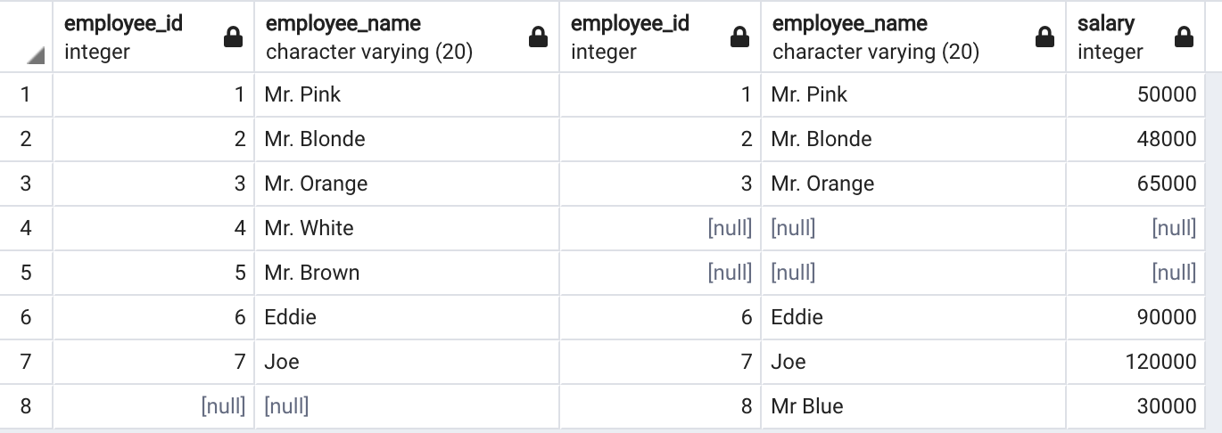
JOIN Statement - FULL OUTER

Slide 28
JOIN Statement - FULL OUTER
FULL [OUTER] JOIN
Rare use case
Discussion about its uses: https://stackoverflow.com/questions/2094793/when-is-a-good-situation-to-use-a-full-outer-join

Slide 29

JOIN Statement
There are four type of JOIN:

Slide 30
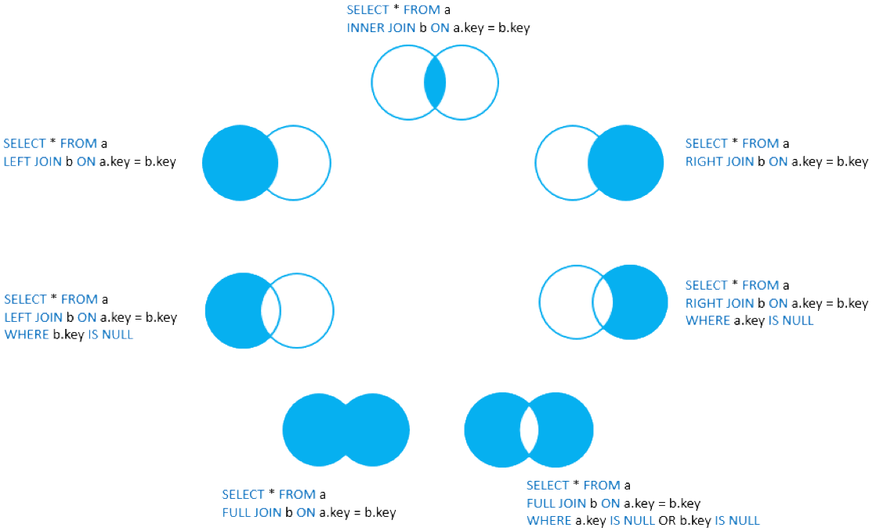
JOIN Statement
https://www.postgresqltutorial.com/postgresql-joins/

Slide 31
Practical - Part II
Use the following tables to complete the Practical
customerID | customerName
1 | Homer
2 | Marge
3 | Bart
4 | Lisa
5 | Maggie
6 | Moe
orderID | customerID | item
1 | 1 | Beer
2 | 2 | Hair product
3 | 2 | Dress
4 | 3 | Juice
5 | 3 | Magazine
6 | 6 | Peanuts

Slide 32
Practical - Part II
Given the following SQL statement:
SELECT c.customerID, c.customerName, o.item FROM customer AS c INNER JOIN order AS o ON c.customerID = o.customerID
What is the:
Number of columns in the returned table?
Number of rows in the returned table?
Number of times customerID “2” would show up?
Number of times customerID “5” would show up?

Slide 33
Practical - Part II
Given the following SQL statement:
SELECT c.customerID, c.customerName, o.item FROM customer AS c LEFT JOIN order AS o ON c.customerID = o.customerID
What is the:
Number of columns in the returned table?
Number of rows in the returned table?
Number of times customerID “2” would show up?
Number of times customerID “5” would show up?

